Slide 1
Day 4

Slide 2
Data Source File
https://drive.google.com/drive/folders/1xcmHEYOB0clh54Y4-3EqEd0Fz8X8KYDk

Slide 3
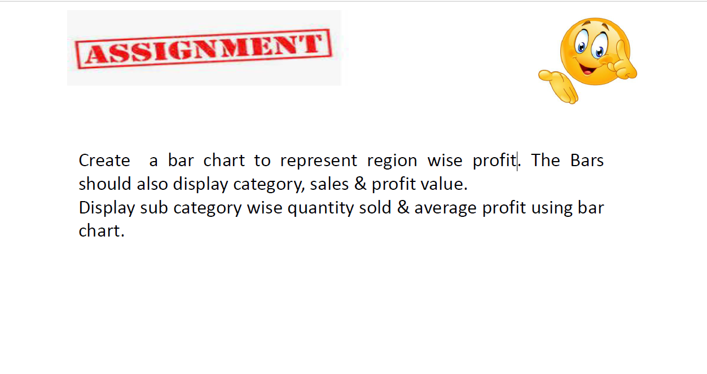
Questions:

Slide 4
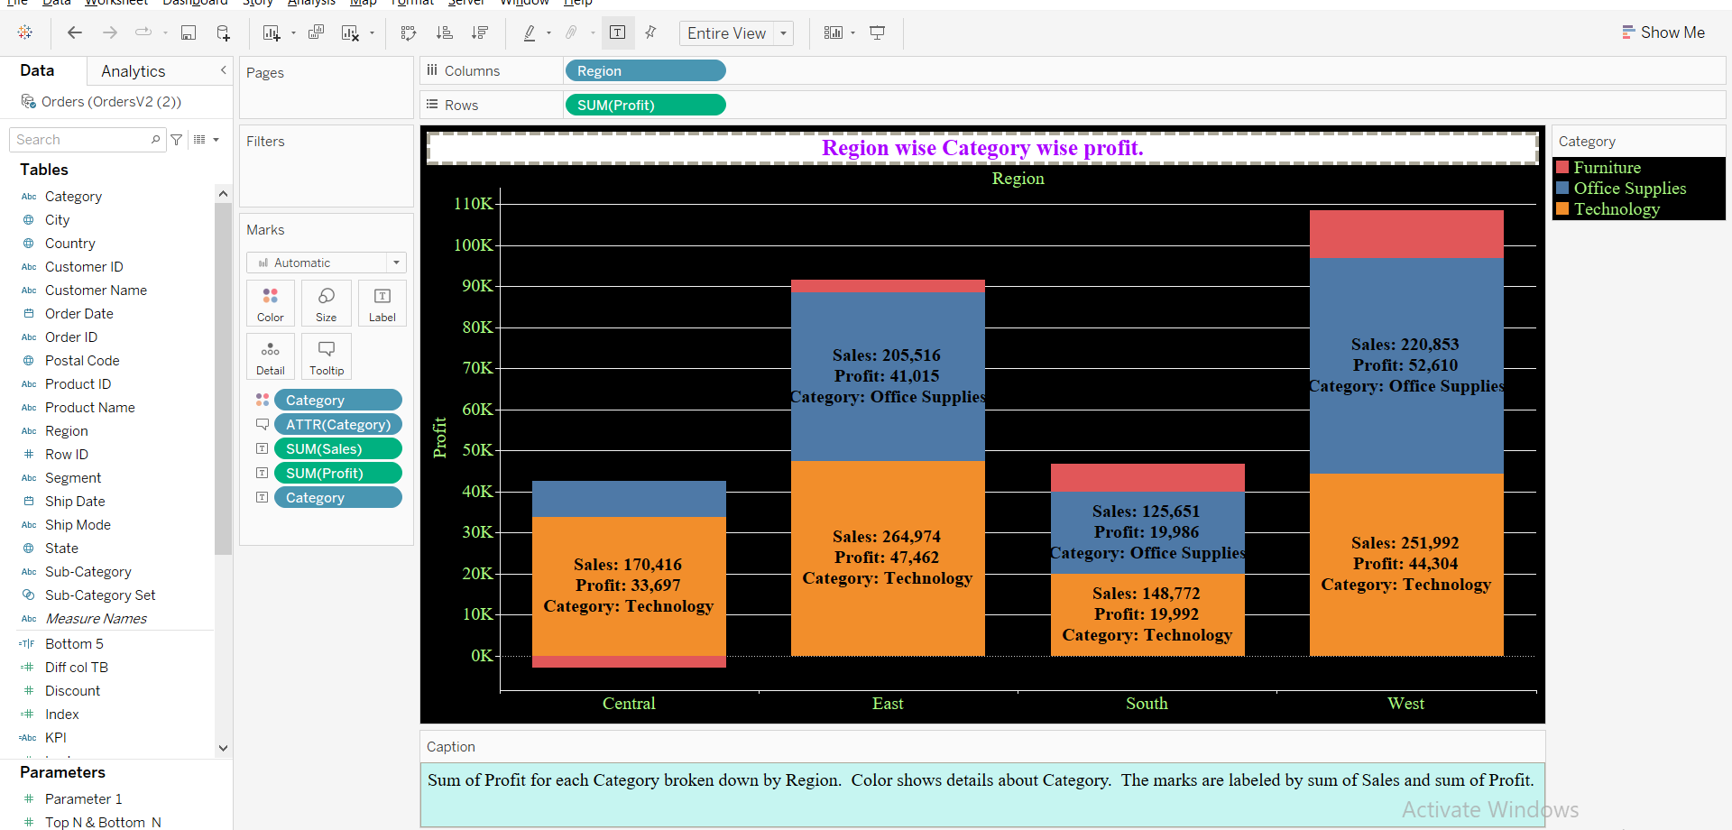
Region wise Category wise profit. Same thing but visually more appealing, easy to understand.

Slide 5
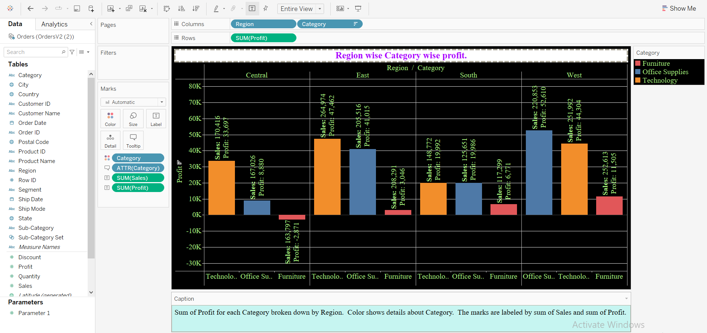
Region wise Category wise profit. Same thing but visually more appealing, easy to understand.

Slide 6
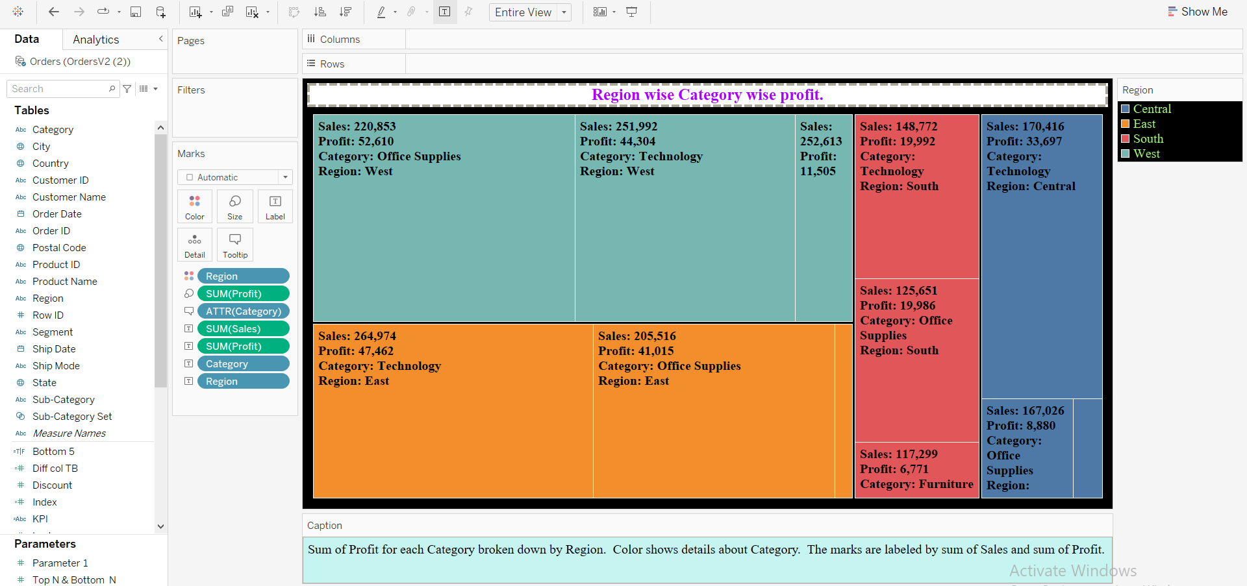
Region wise Category wise profit, Tree method.

Slide 7
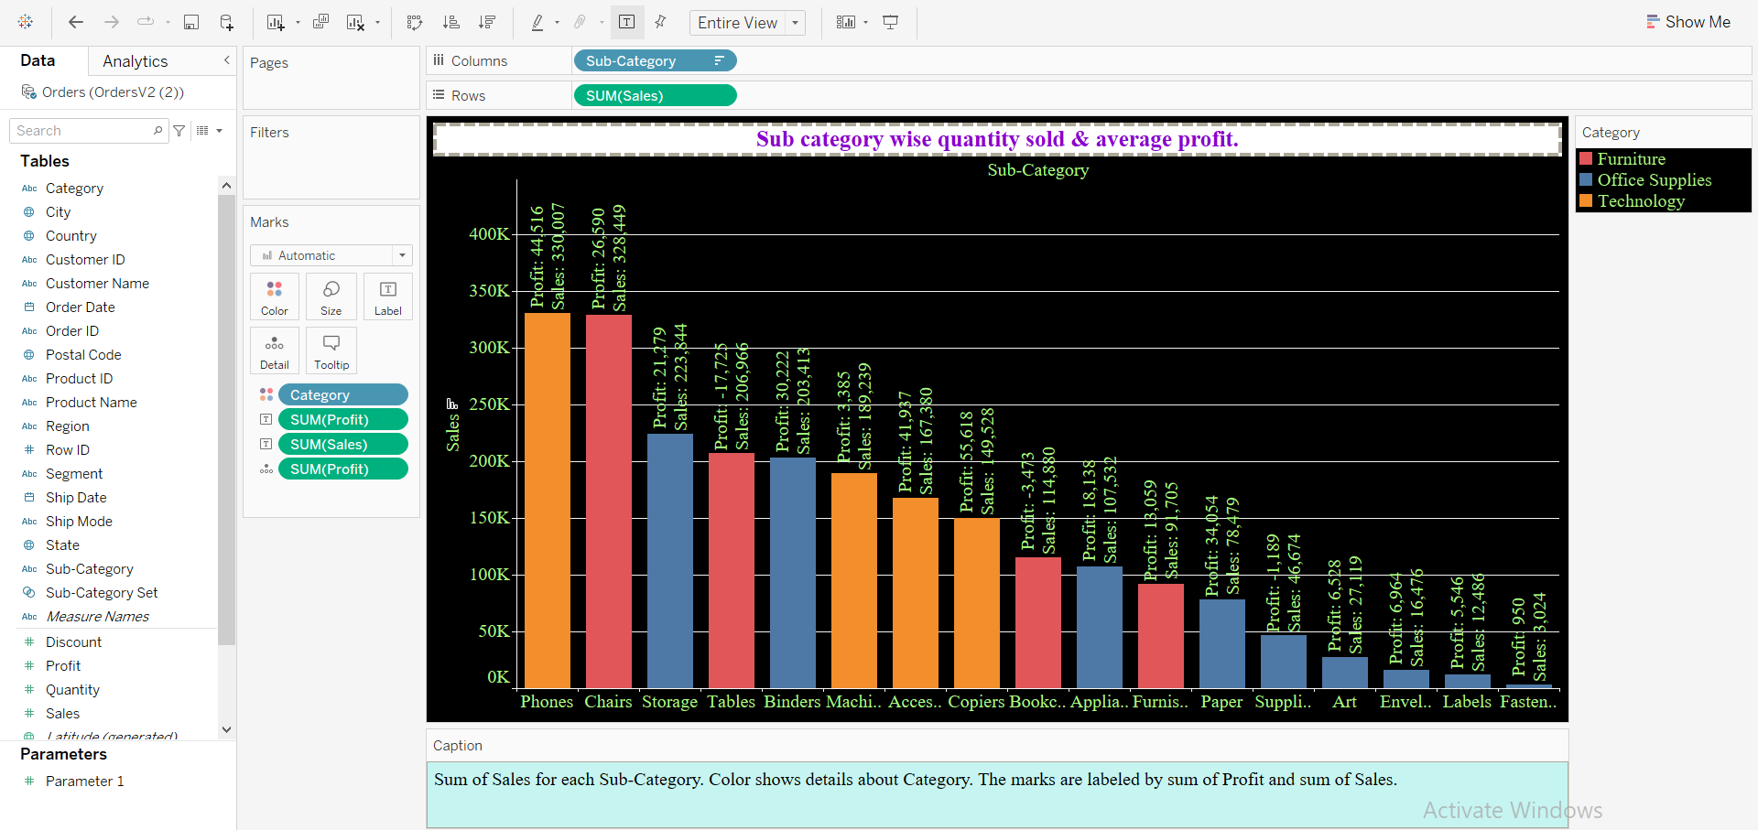
Sub category wise quantity sold & average profit.

Slide 8
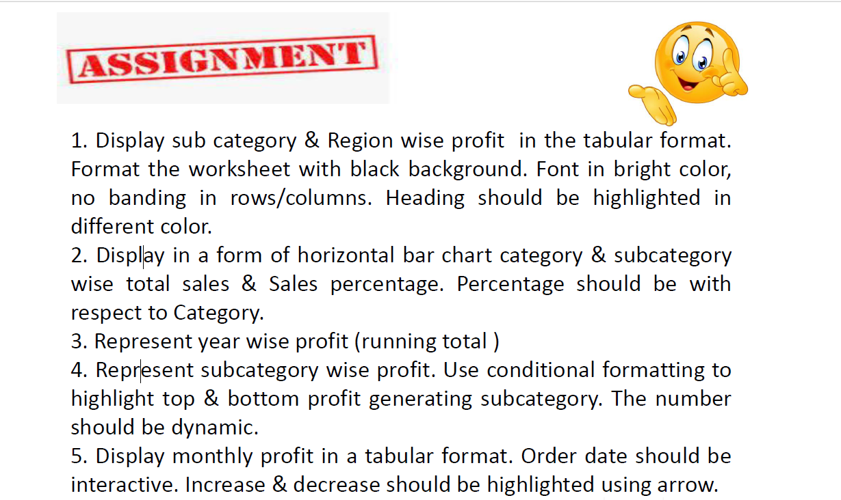
Questions:

Slide 9
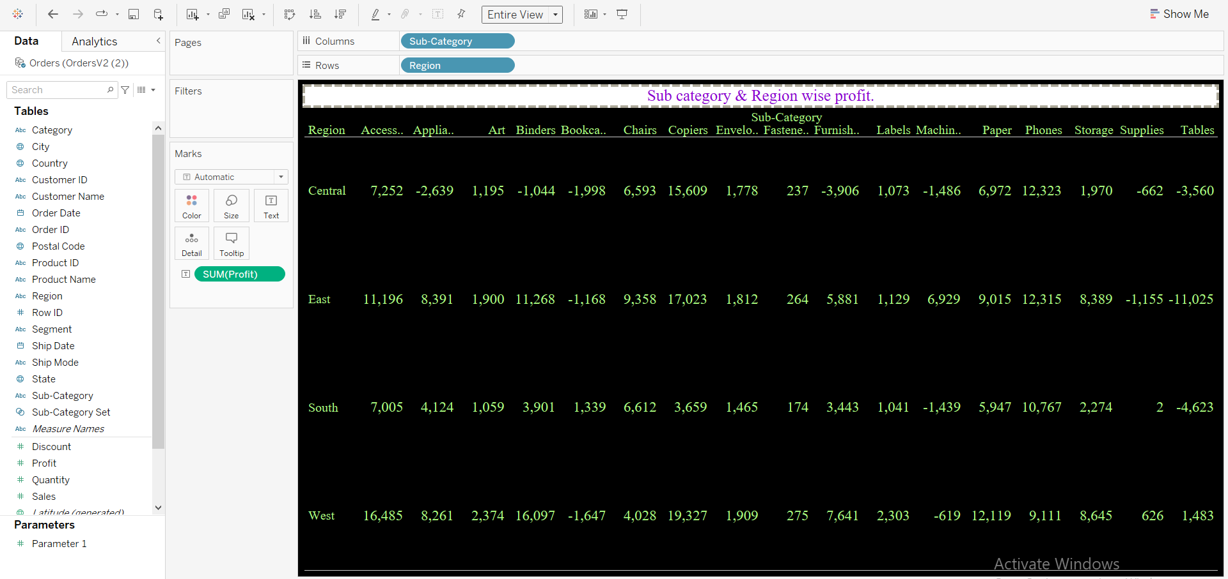
Sub category & Region wise profit.

Slide 10
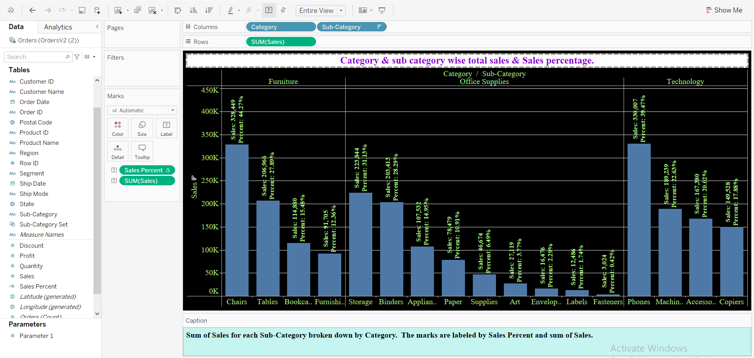
Category & sub category wise total sales & Sales percentage.

Slide 11
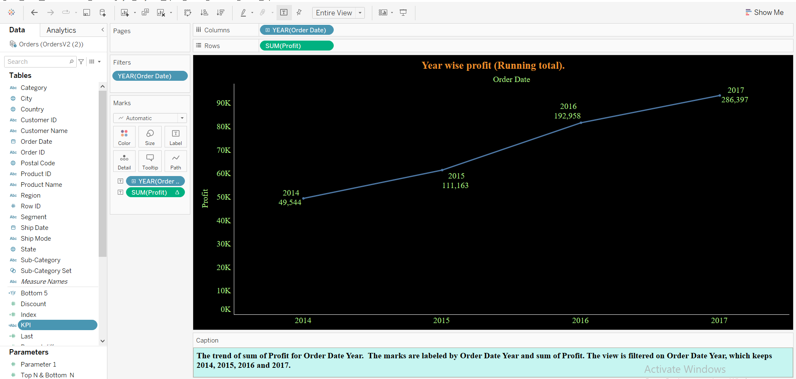
Year wise profit (Running total).

Slide 12
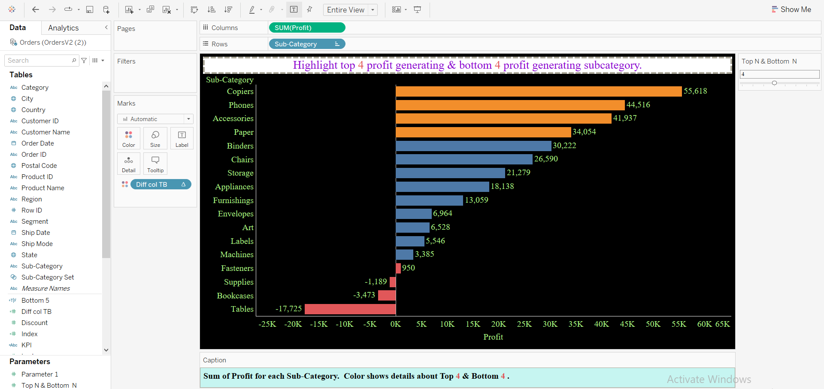
Highlight top & bottom profit generating subcategory.

Slide 13
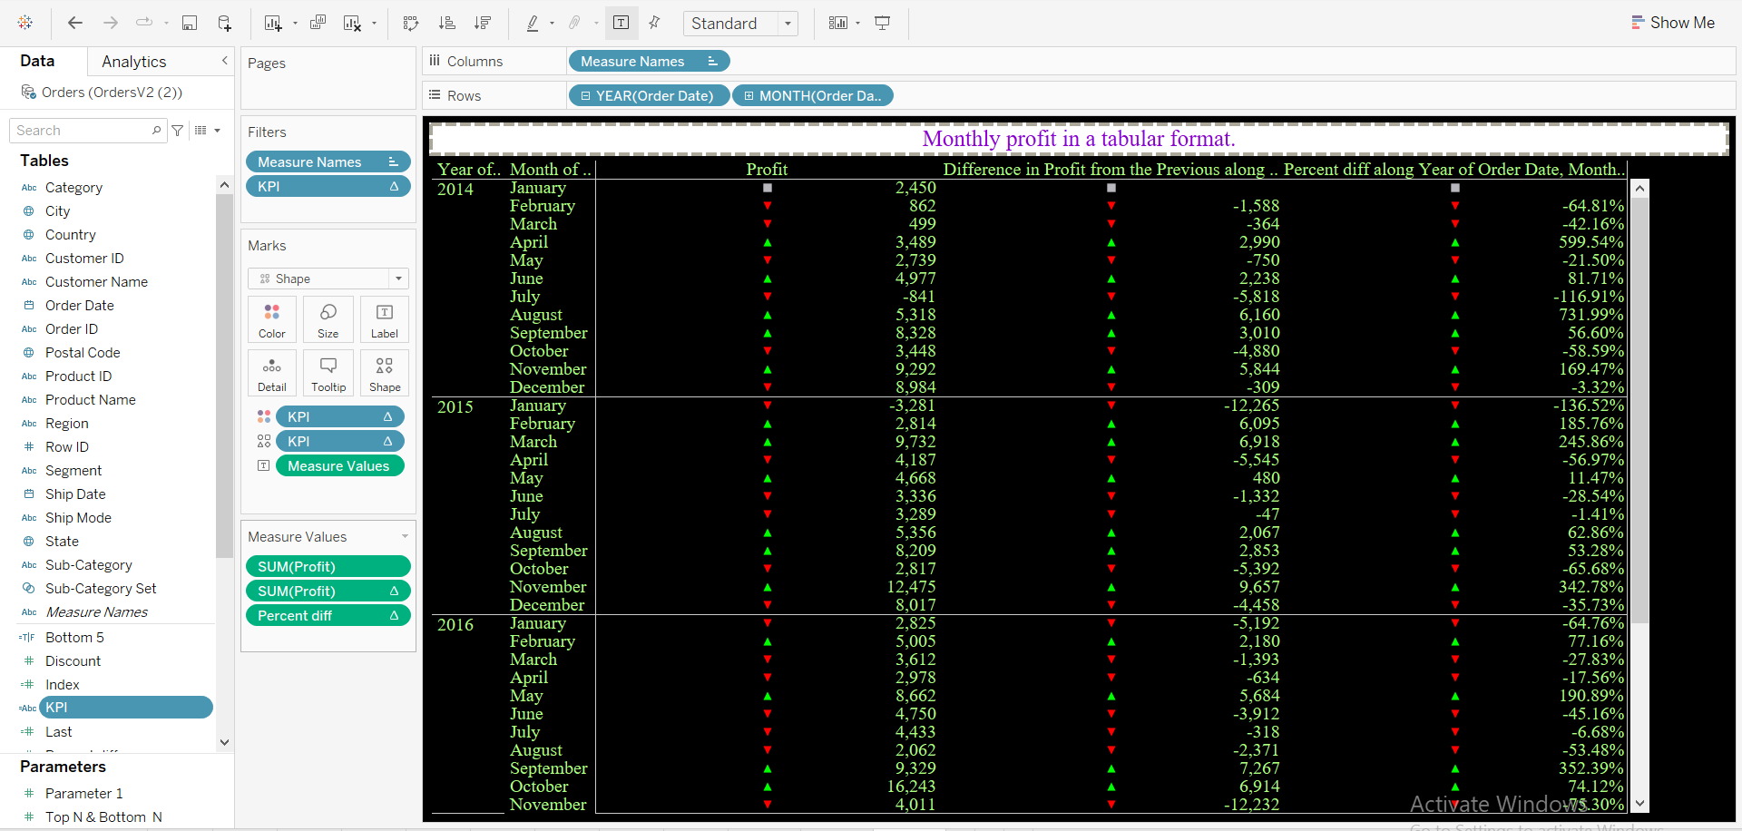
Monthly profit in a tabular format.

